Slide 1


Data Analysis in Power BI

Slide 2





Types of filter
Lecture 3: Summary
Visual level filter
Page level filter
Report level filter
DAX
Calculated Columns
Measure
Table formulas
All
Filter
Calendar
www.dsa.az Bütün hüquqlar qorunur.
DATA SCIENCE ACADEMY
2

Slide 3


I
Types of Filter

Slide 4
Get dataset Northwind
Click Get data and select Odata feed
Place the below link in the window that opens:
https://services.odata.org/Northwind/Northwind.svc/
In the Tables dialog box, select the Order_Details table and click OK
Click the arrow on the Order column and select OrderDate and ShipCountry
Click the arrow on the Product column and select Category
Click the arrow on the Category column and select CategoryName
Select Close&Apply
When you expand the columns by clicking on the arrows, deactivate the Use original column name as prefix option
www.dsa.az Bütün hüquqlar qorunur.
DATA SCIENCE ACADEMY
4

Slide 5
Types of Filter
Visual level filter – applies the filter only to the selected visual
Page level filter – applies a filter to all visuals on the page
Report level filter – applies a filter to all pages and all visuals
Filters have a different principle of operation where some DAX formulas, such as ALL, are used.
www.dsa.az Bütün hüquqlar qorunur.
DATA SCIENCE ACADEMY
5

Slide 6
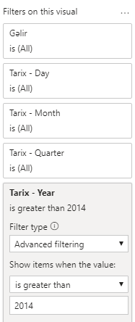
Visual level filter
Create a revenue dynamics visual
Open the Filters window from the windows that appear on the right
In the Filters on this visual section, open the Date-Year drop-down window
Show items when the value is greater than, enter 2014
Click Apply filter
If you want to bring an extra column to filter, you need to drag the required column from the Fields section to the Add data fields here section.
www.dsa.az Bütün hüquqlar qorunur.
DATA SCIENCE ACADEMY
6

Slide 7
II
DAX Functions

Slide 8
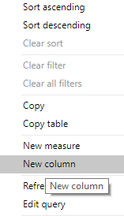
Basic DAX calculations
Click on the table icon in the section to the left of the canvas
Right-click on the Order_Details data and select New Column
Type the following formula in the field for the Formula opened above and press enter
EndirimliQiymet = Order_Details[UnitPrice]*(1-Order_Details[Discount])
Calculate the total discount amount for each customer. To do this, create a new column by multiplying the UnitPrice column to the Discount and Quantity columns.
www.dsa.az Bütün hüquqlar qorunur.
DATA SCIENCE ACADEMY
8

Slide 9
First DAX formulas
SUM
COUNT
AVERAGE
MAX
MIN
COUNTROWS
FILTER
DISTINCT
CONCATENEX
www.dsa.az Bütün hüquqlar qorunur.
DATA SCIENCE ACADEMY
9

Slide 10
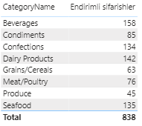
COUNTROWS
On the Home tab, click the New measure button
Type the following DAX in the formula box that opens.
EndirimliSifarisler=COUNTROWS(FILTER(Order_Details, Order_Details[Discount]>0))
Click Enter and drag the created measure to the canvas
Also drag the CategoryName column to the table which contains the measure
Formula Calculates the number of discounted orders
www.dsa.az Bütün hüquqlar qorunur.
DATA SCIENCE ACADEMY
10

Slide 11
DAX iterators
SUMX
COUNTX
AVERAGEX
MAXX
MINX
www.dsa.az Bütün hüquqlar qorunur.
DATA SCIENCE ACADEMY
11

Slide 12
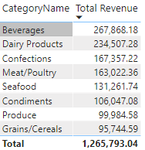
SUMX formula
On the Home tab, click the New measure button
Type the following DAX in the formula box that opens
Click Enter and drag the created dimension to the canvas
Also drag the CategoryName column to the table which contains the measure
Formula multiplies the Discounted price by the Number of orders
TotalRevenue=SUMX(Order_Details, Order_Details[LastPrice]* Order_Details[Quantity])
www.dsa.az Bütün hüquqlar qorunur.
DATA SCIENCE ACADEMY
12

Slide 13
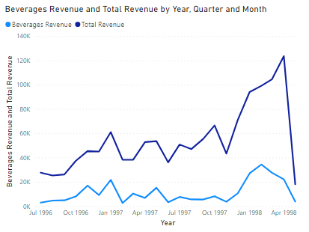
CALCULATE formula
On the Home tab, click the New measure button
Type the following DAX in the formula box that opens
Click Enter and drag the created measure to the canvas
Draw the Total Revenue measure to the table as well
Also drag the OrderDate column to the table and select LineChart from the visualization section
With the formula we can calculate the income of orders with more than 2 orders.
2+Orders=CALCULATE([TotalRevenue],Order_Details[Quantity]>2)
www.dsa.az Bütün hüquqlar qorunur.
DATA SCIENCE ACADEMY
13

Slide 14
Column vs Measure
Calculated Columns are static and do not change
Measures are dynamically changing
Calculated columns are added to the table
Measures are not added to the table
Calculated columns take up space in memory
Measures are not stored in memory and are calculated when the report is opened
Calculated columns can have more than one value
Measures do not have more than one value independently.
www.dsa.az Bütün hüquqlar qorunur.
DATA SCIENCE ACADEMY
14

Slide 15
III
Table Formulas

Slide 16
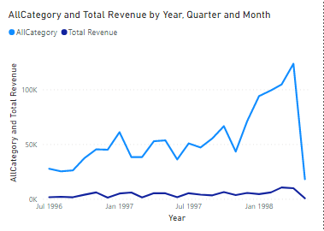
ALL formula
On the Home tab, click the New measure button
Type the following DAX in the formula box that opens
Click Enter and drag the created measure to the canvas
Draw the Total Revenue measure to the table
Also drag the OrderDate column to the table and select LineChart from the visualization section
Create a slicer by dragging the CategroyName column to Canvas and by selecting any category in the slicer you will see total sales and sales of the selected category
This formula will stop the CategoryName column from affecting this calculation using a filter or slicer.
AllCategory = CALCULATE([Total Revenue], ALL(Order_Details[CategoryName]))
www.dsa.az Bütün hüquqlar qorunur.
DATA SCIENCE ACADEMY
16

Slide 17
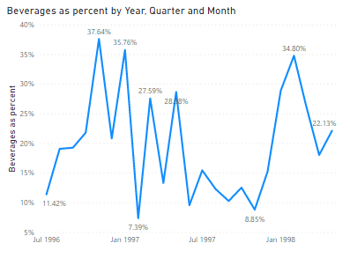
DIVIDE formula
On the Home tab, click the New measure button
Type the following DAX in the formula box that opens
Click Enter and drag the created measure to the canvas
Select our new Measure and switch to the percentage format by clicking on the % sign in the Measure tools section
Also drag the OrderDate column to the table and select LineChart from the visualization section
The formula will only reflect the share of that category in total sales when any CategoryName is selected in the slicer or filter.
Percent of AllCategory= DIVIDE([Total Revenue], [AllCategory], 0)
www.dsa.az Bütün hüquqlar qorunur.
DATA SCIENCE ACADEMY
17

Slide 18
Exercise
Create a measure called Endirim məbləği that will calculate the total discount amount (Discount)
Create a measure that shows the share of total discount in total revenue
Convert the created measure to a percentage format
Create a LineChart showing the share of the discount amount by month
Create a BarChart that calculates the discount percentage on CategoryName
www.dsa.az Bütün hüquqlar qorunur.
DATA SCIENCE ACADEMY
18

Slide 19
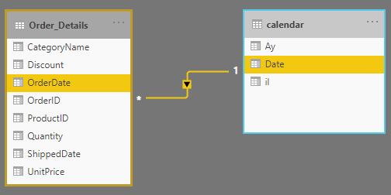
Creating a calendar table
Select a new table from the Modeling tab
Type the following DAX in the formula box that opens
Press Enter and create a relationship as shown in the Model view
calendar = ADDCOLUMNS(
CALENDARAUTO(),
"Ay", FORMAT([Date], "mmm"),
"il", YEAR([Date])
)
www.dsa.az Bütün hüquqlar qorunur.
DATA SCIENCE ACADEMY
19

Slide 20
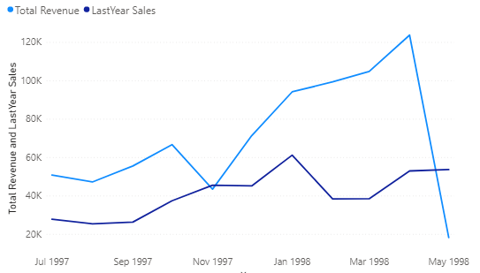
SamePeriodLastYear
On the Home tab, click the New measure button
Type the following DAX in the formula box that opens
Click Enter and add LineChart
PutTotal Revenue and LastYear Sales to the Values section
Put the Date from the Calendar table to the Axis sectionShow sales only 7/1/1997 - 6/1/1998 by applying a visual level filter to the chart
LastYear Sales = CALCULATE([Total Revenue], SAMEPERIODLASTYEAR('calendar'[Date]))
www.dsa.az Bütün hüquqlar qorunur.
DATA SCIENCE ACADEMY
20

Slide 21
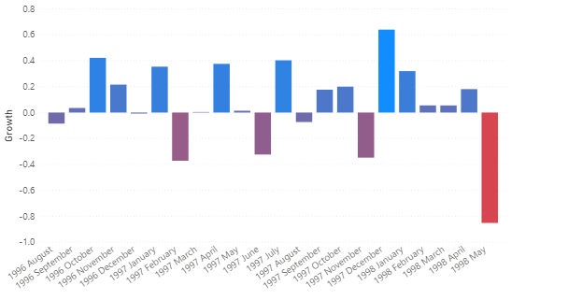
PreviousMonth
On the Home tab, click the New measure button
Type the following DAX in the formula box that opens
Create a new measure
Growth = DIVIDE([Total Revenue], [LastMonth Revenue], 0)-1
Add a Clustered ColumnChart
Add Growth to the Values section, and Year, Month from the Calendar table to the Axis section
Eliminate cases with Growth -1 by applying a visual level filter to the graph.
LastMonth Revenue = CALCULATE([Total Revenue], PREVIOUSMONTH('calendar'[Date]))
www.dsa.az Bütün hüquqlar qorunur.
DATA SCIENCE ACADEMY
21

Slide 22
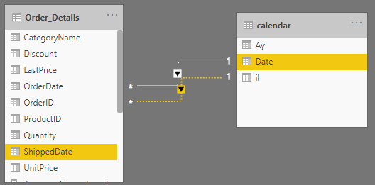
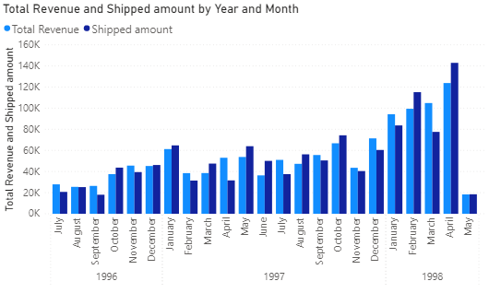
UseRelationship formula
In the model view, create relationship between ShippedDate and Date from the calendar tableCreate a new measure.
Shipped amount = CALCULATE([Total Revenue], USERELATIONSHIP('calendar'[Date], Order_Details[ShippedDate]))
Add a Clustered ColumnChart.
In the Axis section, bring the Total revenue and Shipped amount measuremes from the calendar table to the Date values section.
www.dsa.az Bütün hüquqlar qorunur.
DATA SCIENCE ACADEMY
22

Slide 23
FILTER and Averagex formula
Create a new measure
Type the following DAX in the formula box that opens
Average discount small =
AVERAGEX(
FILTER(Order_Details,
Order_Details[Quantity]>2
&&Order_Details[Quantity]<15),
Order_Details[Discount]*Order_Details[UnitPrice]*Order_Details[Quantity])
Click Enter and center the measure you created and view the results.
The formula calculates the total discount amount for orders over 2 and under 15.
www.dsa.az Bütün hüquqlar qorunur.
DATA SCIENCE ACADEMY
23

Slide 24
Thank you!

